Slide 1

PRESENTATION

Slide 2
Independent Watchdog
(IWDG)

Slide 3
What is IWDG?

Slide 4
IWDG Main Features
Free-running downcounter
Clocked from an independent RC oscillator (can operate in Standby and Stop modes)
Reset (if watchdog activated) when the downcounter value of 0x000 is reached

Slide 5
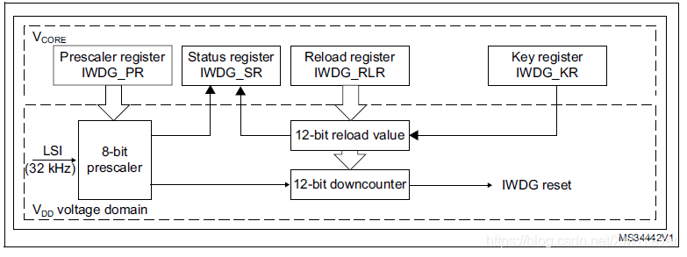
IWDG Block Diagaram

Slide 6
IWDG Registers
Key Register
Prescaler Register
Reload Register
Status Register

Slide 7
Key Register
Address offset: 0x00
Reset value: 0x0000 0000

Slide 8
Prescale Register
Address offset: 0x04
Reset value: 0x0000 0000

Slide 9
Reload Register
Address offset: 0x08
Reset value: 0x0000 0FFF

Slide 10
Status Register
Address offset: 0x0C
Reset value: 0x0000 0000

Slide 11
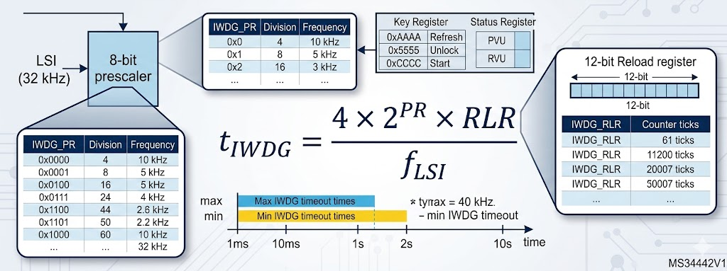

Slide 12
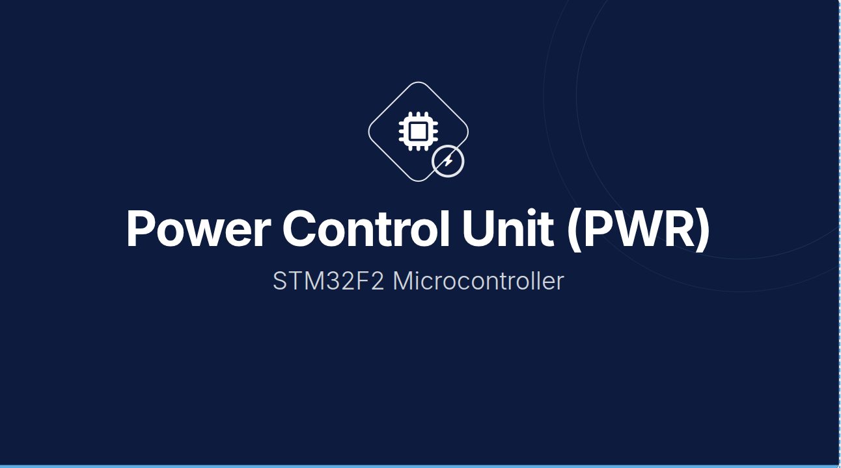

Slide 13
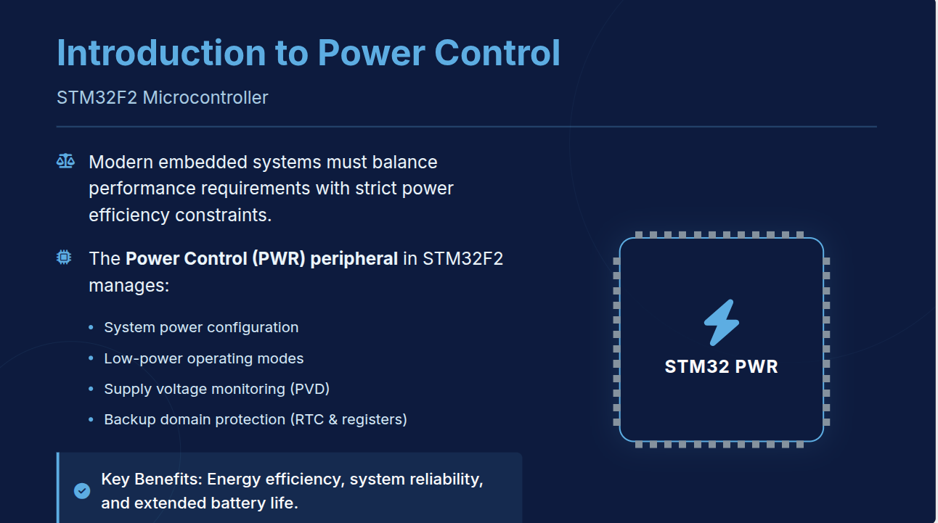

Slide 14
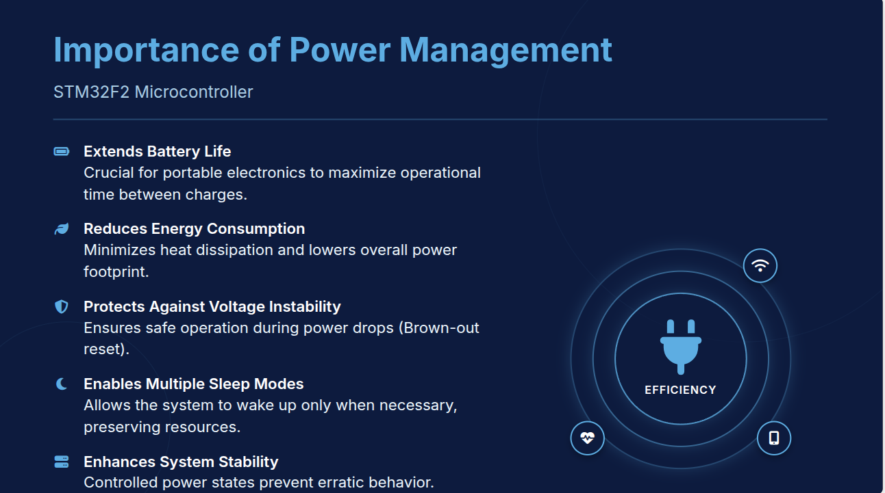

Slide 15
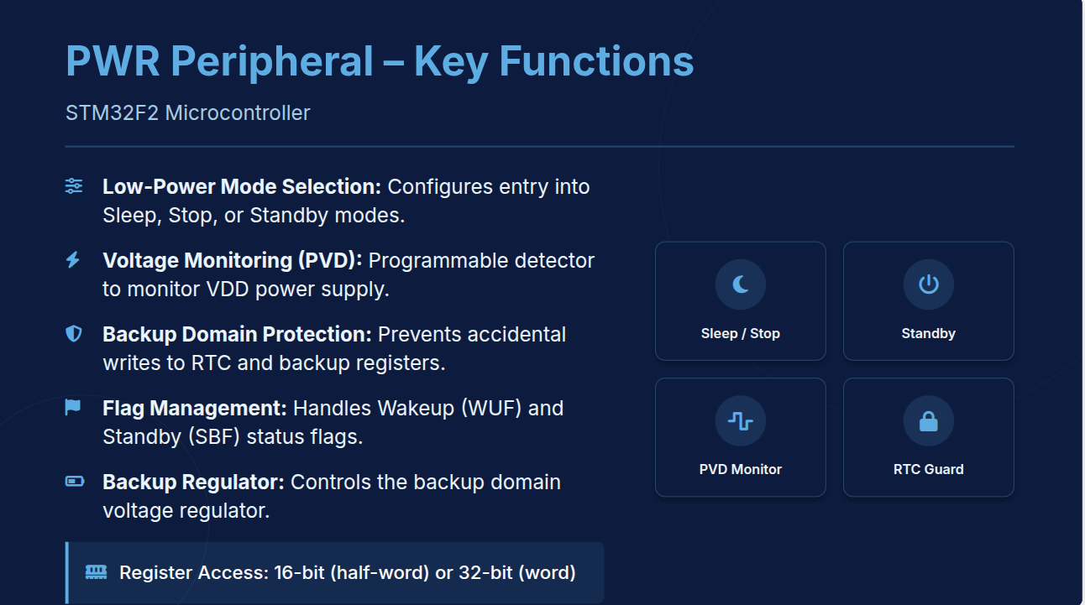

Slide 16
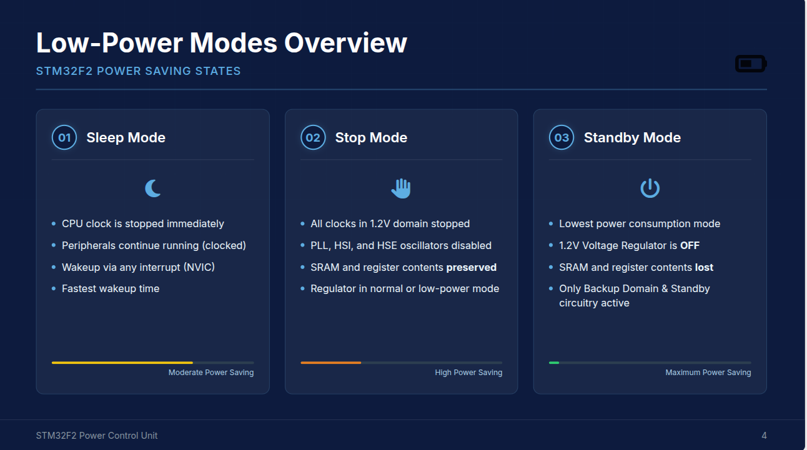

Slide 17
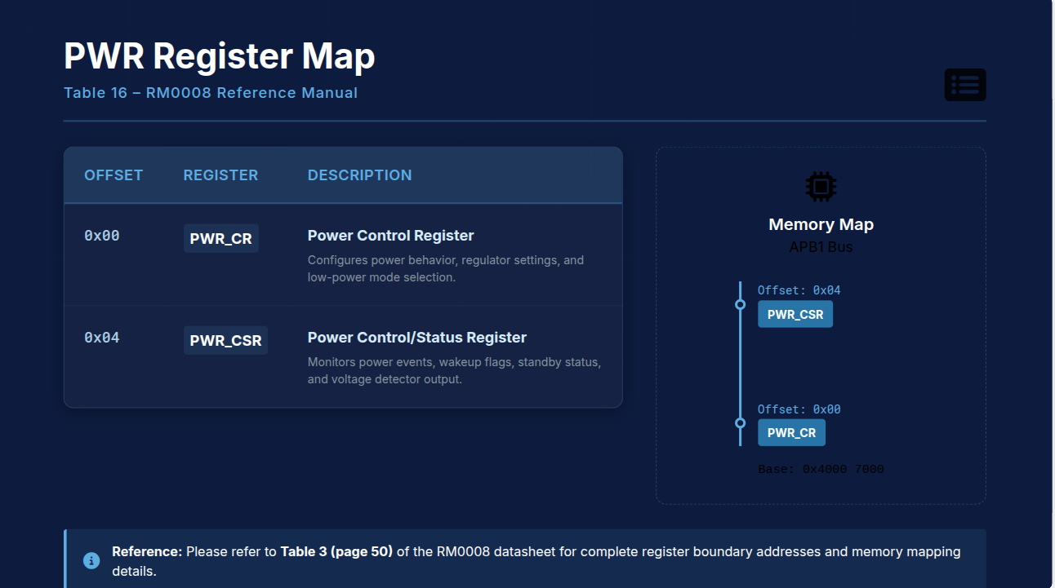

Slide 18
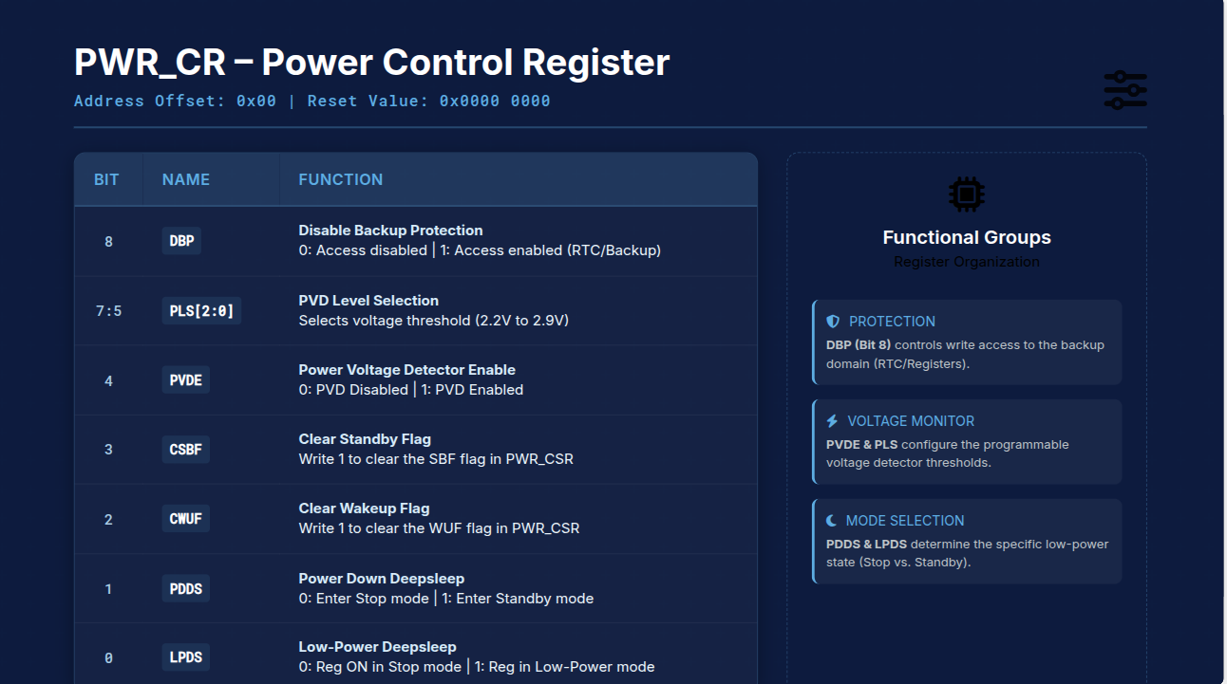

Slide 19
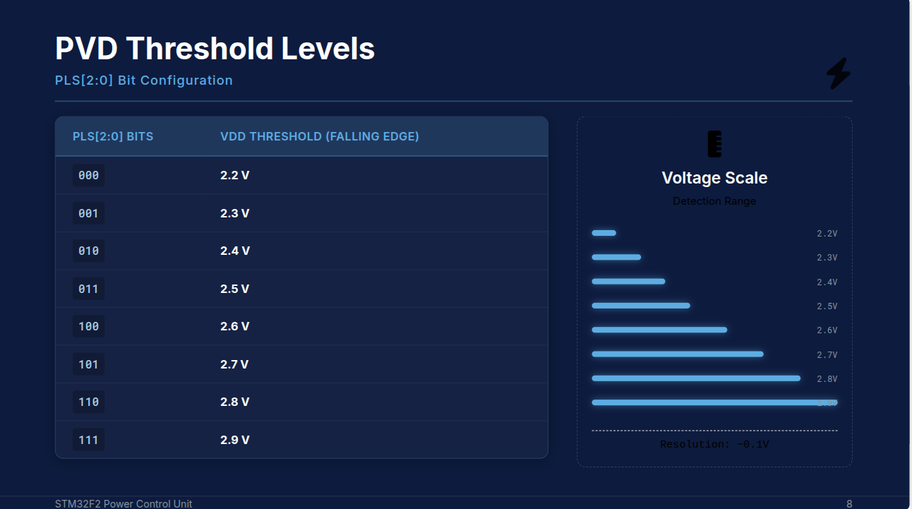

Slide 20
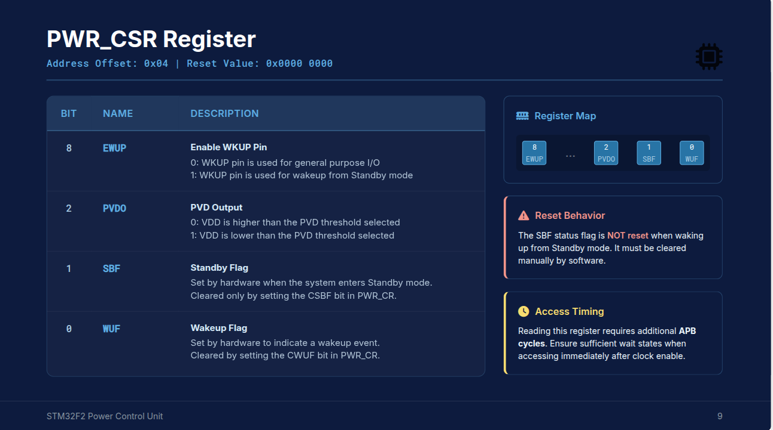

Slide 21
